Slide 1





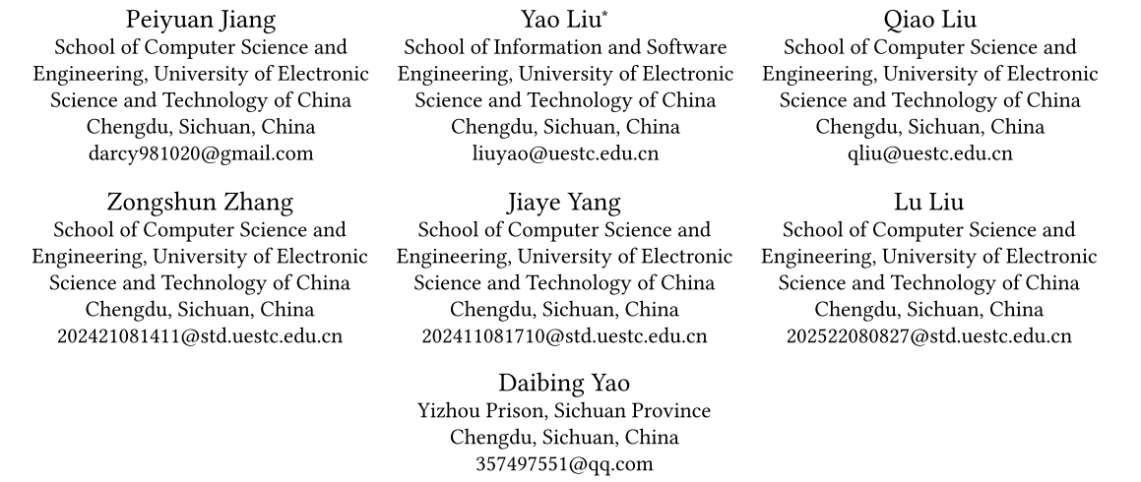



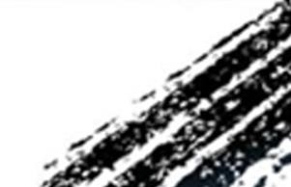

ATAI
Advanced Techniqueof Artificial Intelligence
ATAI
ChongqingUniversity _{AdvancedTechniqueof}
of Technology Artificial Intelligence
Chongqing University of
Technology
Chongqing University ^{ATAI}
_{of Technology} Advanced Techniqueof
Artificial Intelligence
Chongqing University of Technology
Chongqing University of Technology
DRKF: Decoupled Representations with Knowledge Fusion for Multimodal Emotion Recognition
Code: https://github.com/PANPANKK/DRKF
—— MM_2025
Reported by HongLiang Nie
1

Slide 2

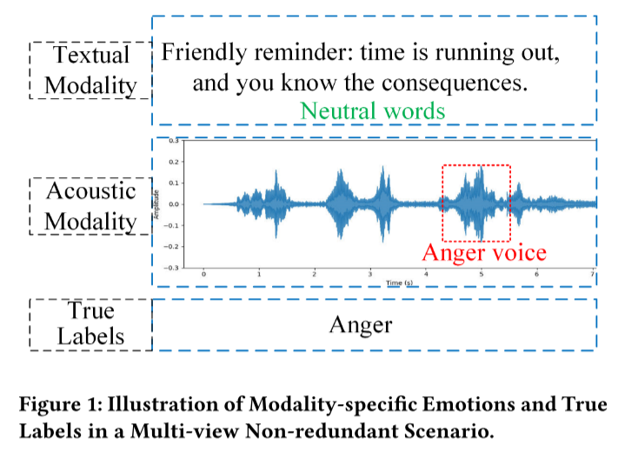
ATAI
AdvancedTechniqueof
Artificial Intelligence
ATAI
ChongqingUniversity _{AdvancedTechniqueof}
of Technology Artificial Intelligence
ChongqingUniversity of Technology
Motivation
1：inherent modality heterogeneity and inconsistencies in emotional cues remain key challenges that hinder performance
2：The MER’s fundamental concept is to acquire modality representations and subsequently fuse them. In representation learning, contrastive
learning-based methods have been widely applied to various multimodal tasks . These methods rely on the multi-view redundancy assumption, which states that the shared information across different modalities can sufficiently capture the critical features required for downstream tasks.

Slide 3

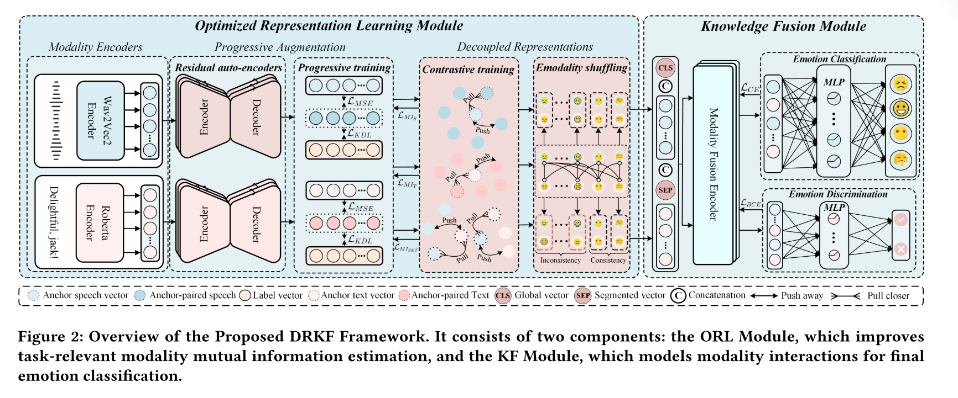
ChongqingUniversity of Technology
ATAI
AdvancedTechniqueof
Artificial Intelligence
ATAI
ChongqingUniversity _{AdvancedTechniqueof}
of Technology Artificial Intelligence
Overview

Slide 4
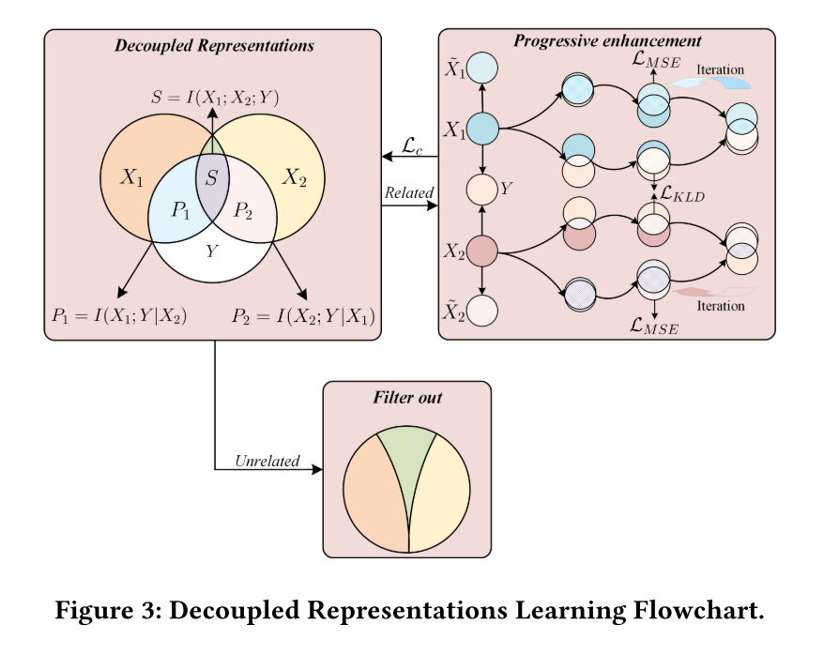

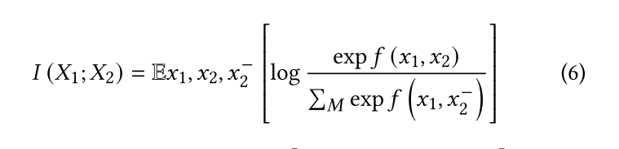

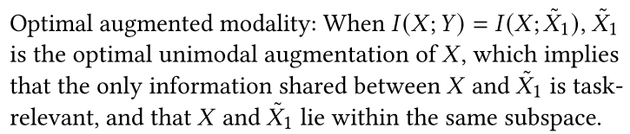
ChongqingUniversity of Technology
ATAI
AdvancedTechniqueof
Artificial Intelligence
ATAI
ChongqingUniversity _{AdvancedTechniqueof}
of Technology Artificial Intelligence
Method

Slide 5
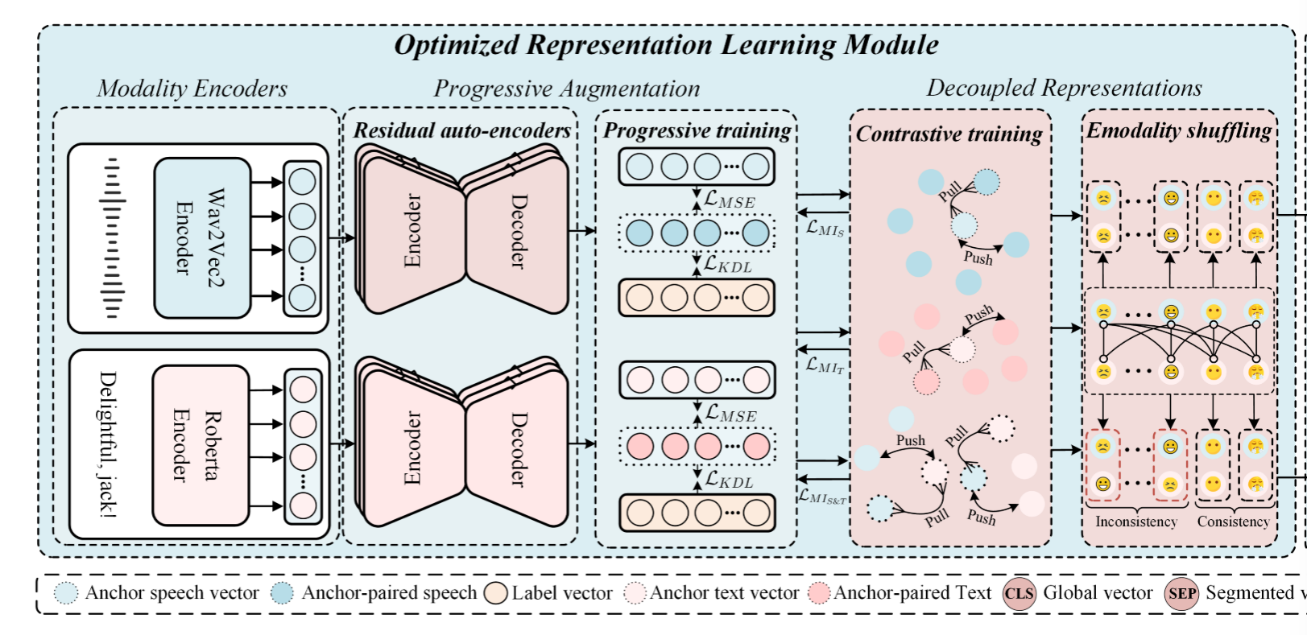
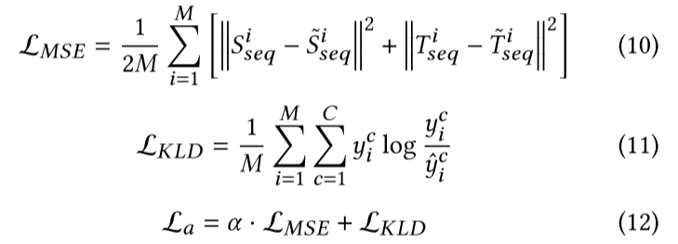
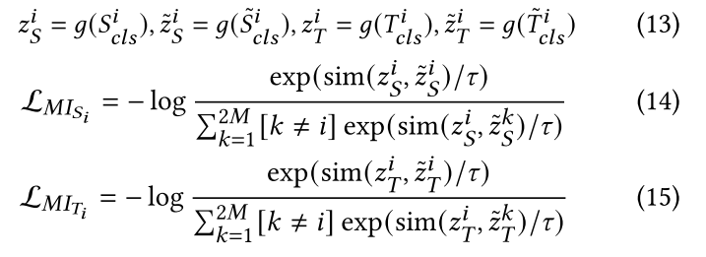
ChongqingUniversity of Technology
ATAI
AdvancedTechniqueof
Artificial Intelligence
ATAI
ChongqingUniversity _{AdvancedTechniqueof}
of Technology Artificial Intelligence
Method

Slide 6
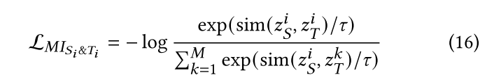
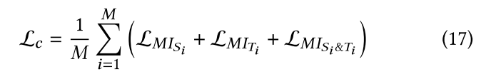
ChongqingUniversity of Technology
ATAI
AdvancedTechniqueof
Artificial Intelligence
ATAI
ChongqingUniversity _{AdvancedTechniqueof}
of Technology Artificial Intelligence
Method

Slide 7
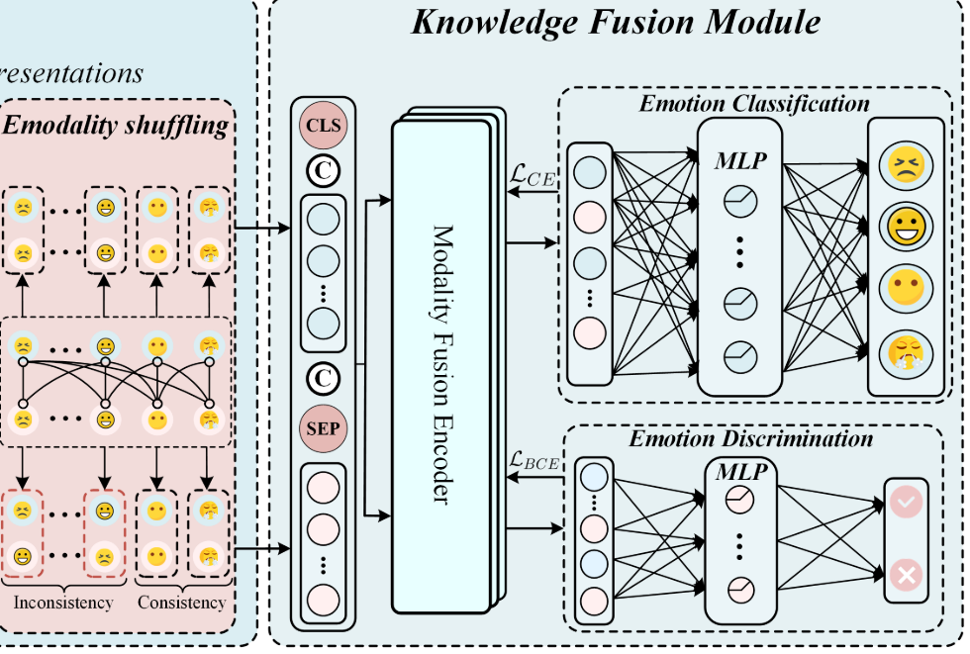


ChongqingUniversity of Technology
ATAI
AdvancedTechniqueof
Artificial Intelligence
ATAI
ChongqingUniversity _{AdvancedTechniqueof}
of Technology Artificial Intelligence
Method

Slide 8

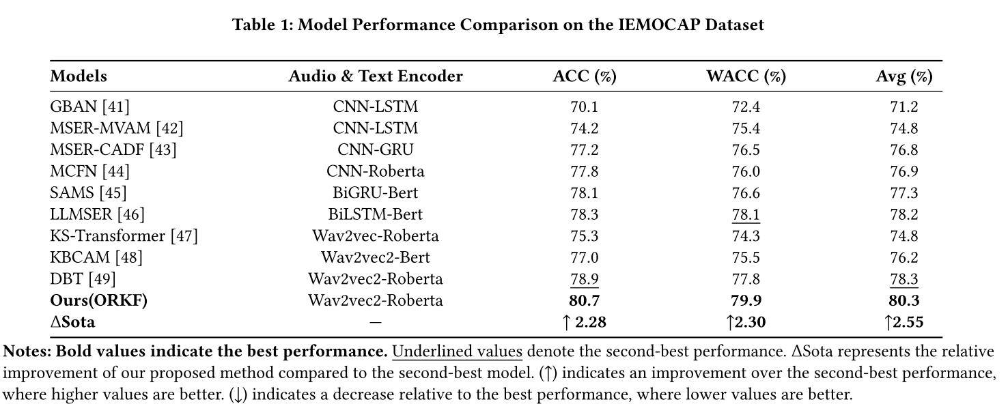
ATAI
AdvancedTechniqueof
Artificial Intelligence
ATAI
ChongqingUniversity _{AdvancedTechniqueof}
of Technology Artificial Intelligence
ChongqingUniversity of Technology
Experiments

Slide 9
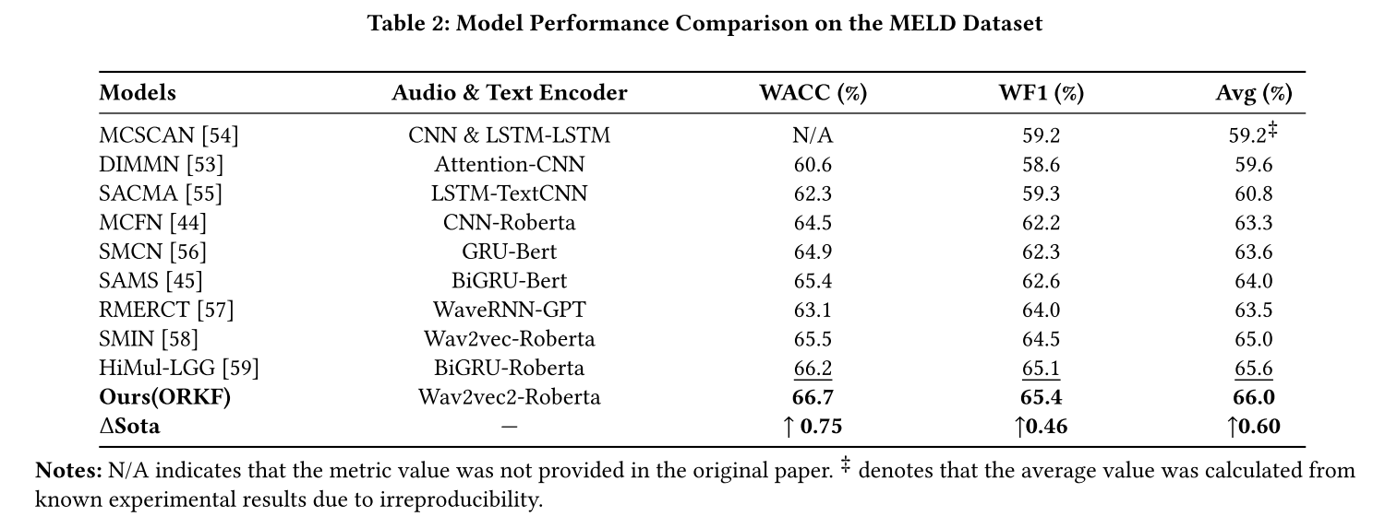
ATAI
AdvancedTechniqueof
Artificial Intelligence
ATAI
ChongqingUniversity _{AdvancedTechniqueof}
of Technology Artificial Intelligence
ChongqingUniversity of Technology
Experiments

Slide 10
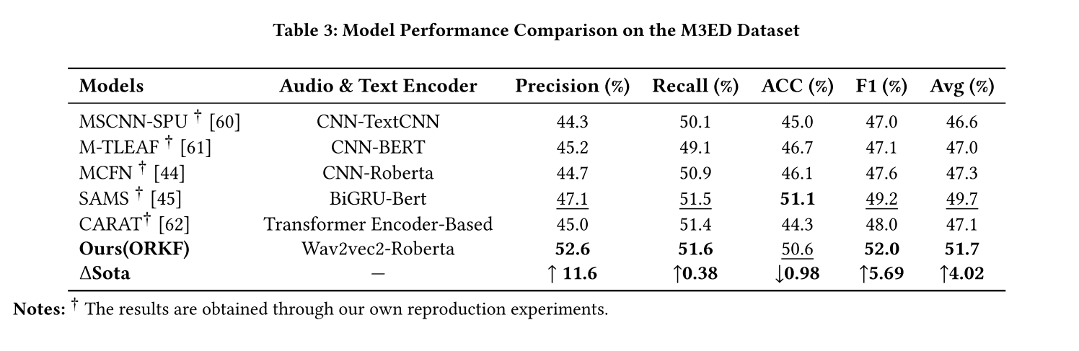
ATAI
AdvancedTechniqueof
Artificial Intelligence
ATAI
ChongqingUniversity _{AdvancedTechniqueof}
of Technology Artificial Intelligence
ChongqingUniversity of Technology
Experiments

Slide 11
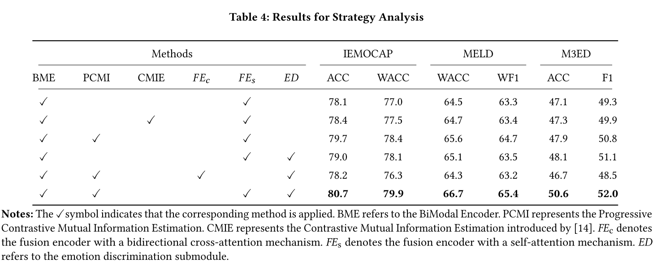
ATAI
AdvancedTechniqueof
Artificial Intelligence
ATAI
ChongqingUniversity _{AdvancedTechniqueof}
of Technology Artificial Intelligence
ChongqingUniversity of Technology
Experiments

Slide 12
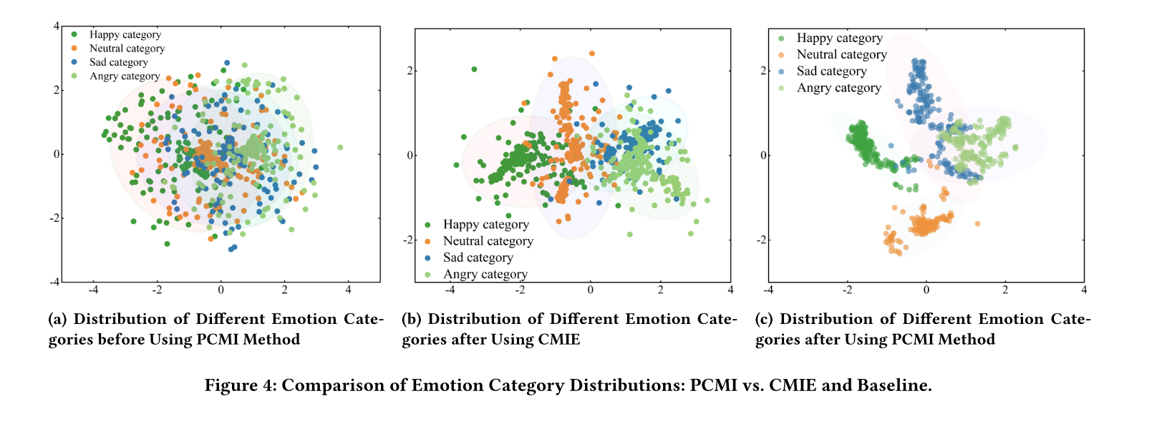
ATAI
AdvancedTechniqueof
Artificial Intelligence
ATAI
ChongqingUniversity _{AdvancedTechniqueof}
of Technology Artificial Intelligence
ChongqingUniversity of Technology
Experiments

Slide 13


ChongqingUniversity of Technology
ATAI
AdvancedTechniqueof
Artificial Intelligence
ATAI
ChongqingUniversity _{AdvancedTechniqueof}
of Technology Artificial Intelligence
Thanks!

